Slide 1
Visual Design Development
Student Name
Date

Slide 2
Introduction
This offer provides high-end yoga products like mats, blocks, straps, and accessories at a 50% discount for a short time with the objective of inviting fresh and frequent yoga practitioners to try the brand.
Yoga has become very popular, which is a sign of increased interest in wellness, health, and mindfulness.
The campaign objective is to connect global brand positioning, which is quality, durability, sustainability, and lifestyle enhancement, coupled with local cultural affinity, thereby enabling advertising that would appeal to consumers.

Slide 3
Audience Analysis
The primary target market for this campaign is healthy adults aged 20–45 who live in suburban and urban communities across the United States.
This includes both men and women who either already practice yoga on a regular basis or are looking for health routines for the first time.
This is an active demographic that prioritizes personal health, mindfulness, and stress reduction.
They are drawn to items that enhance their physical well-being, provide comfort and durability, and are environmentally sustainable.

Slide 4
…
Cultural considerations are at the root of this campaign definition. Yoga, in the United States, is largely synonymous with self-care, stress relief, and full-body wellness.
Shared practice areas are public parks, home practice studios, and professional yoga studios, and material that reflects these areas resonates strongly.
Visuals showcasing diverse body types, genders, and ethnicities offer inclusivity and a feeling of relatability that appeals to U.S. cultural expectations for socially aware and representative advertising.

Slide 5
Design Insights
The visual strategy for the campaign is creating a clean, modern, and aspirational visual world that will connect with U.S. consumers while maintaining the global brand personality.
Colors play a crucial role in projecting wellness and energy. Repetitive use of brand colors—calming blue and green—is used to highlight trust, balance, and health, while accent colors such as warm yellow and coral are used to add energy, enthusiasm, and activity.
These accent colors also highlight the important points, such as the 50% discount offer and call-to-action, without creating a sense of clutter in the overall design.

Slide 6
Typography has been chosen based on clarity, legibility, and contemporary charm.
Headlines employ bold, sans-serif typefaces to grab attention instantly, while body text uses clean, readable typefaces that present the information in a clear manner.
Text overlays in online media, particularly the 5-second pre-roll YouTube ad, are concise and strategically located to be readable and with most impact within the time constraint.
Print ads achieve a balance of hierarchy and legibility, with the use of heavier fonts for main messages and lighter fonts for product detail, QR code, and secondary information.

Slide 7
Messaging Strategy
Ad 1 (Image-Centric): The ad centers around aspirational lifestyle imagery of individuals practicing yoga in serene outside or studio settings.
The message is concise and direct, with the 50% discount deal taking center stage, keeping text to a bare minimum so that the imagery can capture the heartstrings of the audience.
The tone is approachable and aspirational, encouraging consumers to visualize themselves using the products on their own wellness routines.

Slide 8
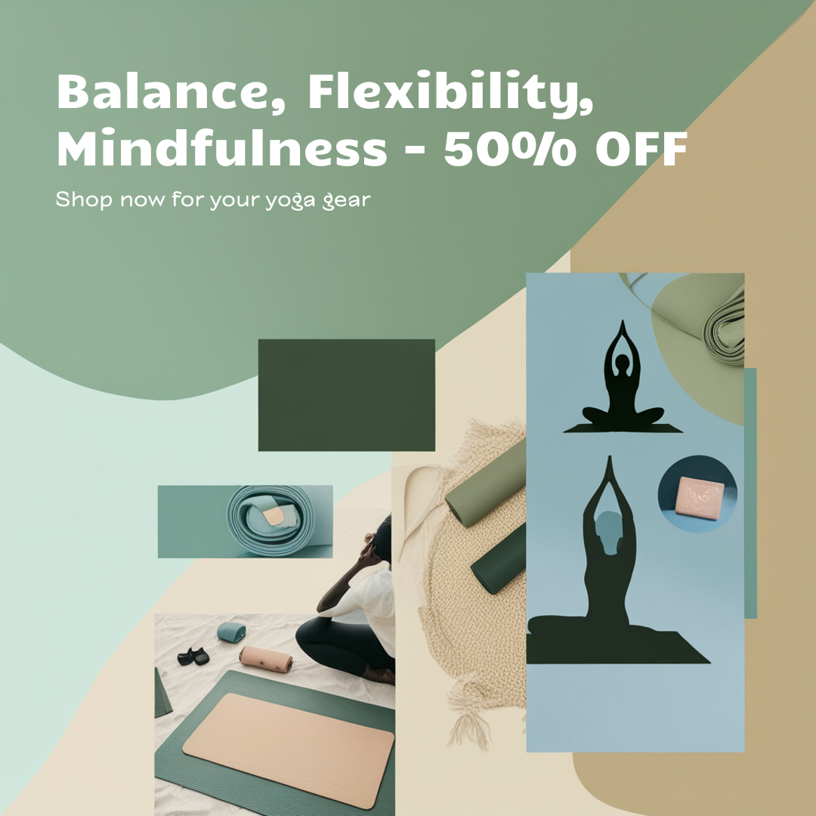

Slide 9
AD 2
Ad 2 (Text-Focused): More precise product information like durability, eco-friendly materials, and versatility of mat, block, and strap is provided in this ad.
Value and quality communication is highlighted with explicit reference to the 50% offer for a limited time.
A positive and urging tone, which is addressing consumers seeking usefulness and lifestyle enrichment, is applied.

Slide 10


Slide 11
AD 3
Ad 3 (Hybrid): Merging lifestyle imagery with copy, this ad has a balance between inspiring and educating.
The copy highlights product excellence, wellness value, and promotion deal, and an explicit visual cue directs the viewer to the call-to-action.

Slide 12


Slide 13
YouTube Pre-Roll Ad (5 Seconds)
For the internet medium, messaging is immediate and highly visual.
Key catchphrases such as "Yoga Essentials", "50% Off Now!", and "Shop Now" blink on screen in rapid succession, following short lifestyle and product cuts.
The mood is upbeat, inspirational, and provocative, designed to grab attention in the first two seconds and hold viewer interest through.
The message generates a sense of urgency and magnificence of the offer, which induces immediate action.

Slide 14
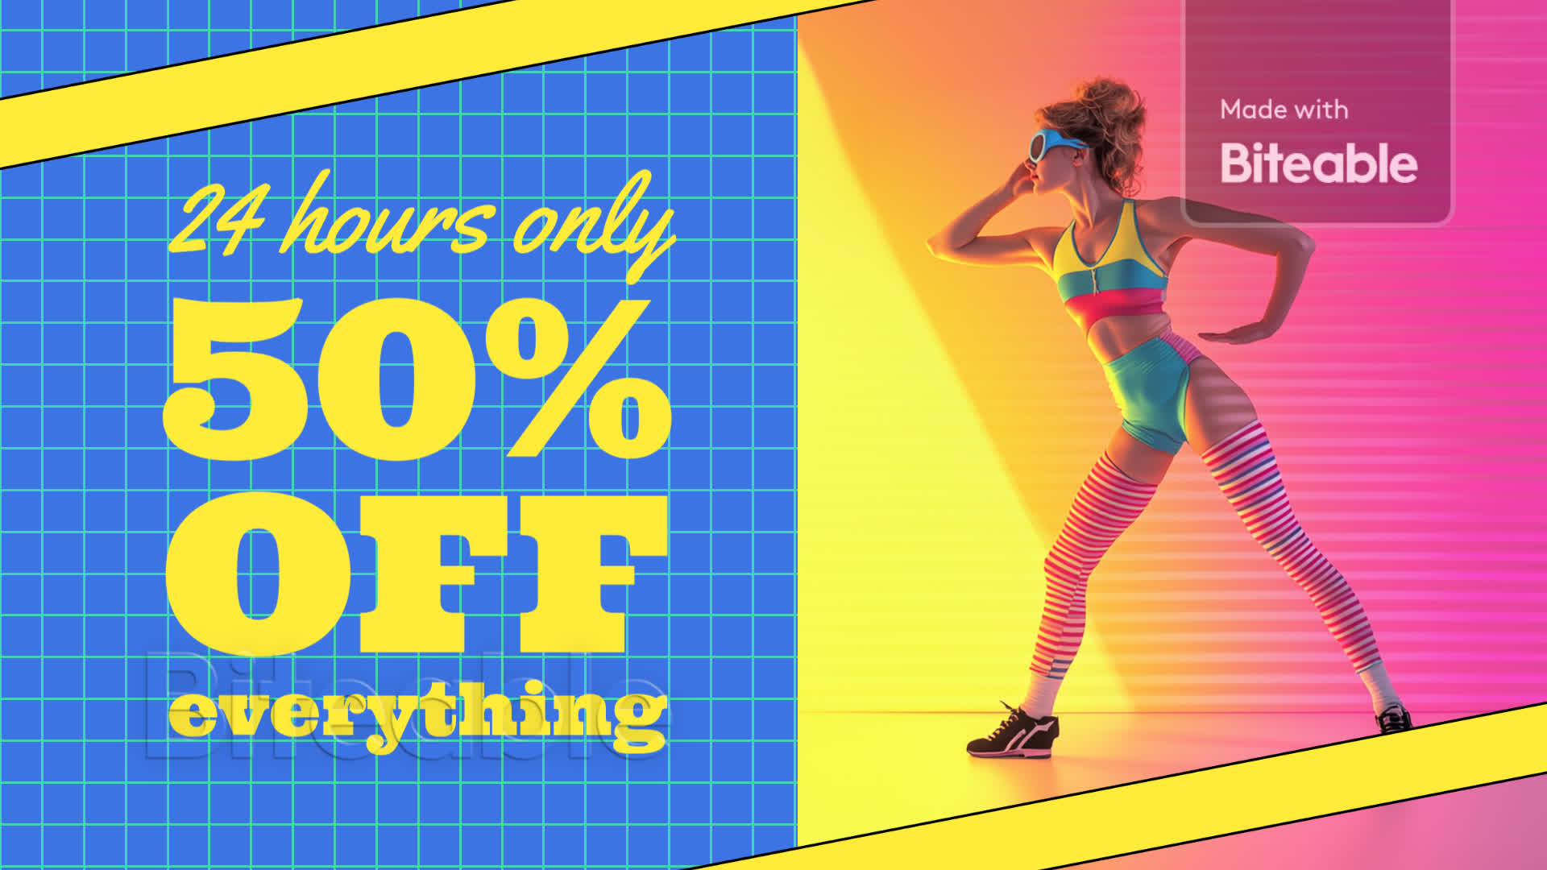

Slide 15
Tone of Voice
Across all the ads, tone is friendly, inspirational, and motivational.
Messaging avoids using overly formal or technical language but rather infuses wellness, awareness, and harmony.
The purpose is to encourage consumers to incorporate yoga into their lives while highlighting ease of access and worth of the 50% discount.

Slide 16
Call-to-Action Strategy:
Calls-to-action (CTAs) are medium-specific. Print ads display QR codes, web URLs, and lines such as "Shop Now" or "Get Your 50% Off Today," enticing immediate emotional responses.
The YouTube pre-roll ad utilizes a prominent on-screen CTA overlay—"Shop Now," complemented by the brand name and close-ups of the product to guide the audience directly to purchasing.
The combination of urgency, ease, and accessible prompts enables audiences to understand exactly what they must do and feel an urge to do so immediately.

Slide 18
Conclusion
This campaign beautifully brings together worldwide brand identity and local interest for the U.S. consumer.
In featuring global standards of brand color, logo, and messaging, the commercials convey quality, longevity, and wellness values without losing an international image that is recognizable.
On the other hand, culturally relevant imagery—like street yoga, home practice gear, and multicultural practitioners—ensures that the campaign resonates with U.S. consumers' way of life, wellness habits, and visual sensitivities.
The combination of three print ads with a 5-second YouTube pre-roll ad allows the brand to connect with consumers across different touchpoints, reinforcing a consistent message of quality and value through the 50% discount offer.

